Slide 1

Exploratory Data Analysis On
Fortune 500 Companies

Slide 2
Quick Introduction About me
Challa Rakesh Reddy
Aspiring Data Scientist Trainee with a strong foundation in Information Technology, graduated from Sree Vidyanikethan Engineering College, Tirupati (2024).
Passionate about data analysis, visualization, and web scraping, with expertise in Python, NumPy, Beautiful Soup, Pandas, and Matplotlib.
Looking forward to making an impact in the data science field by mastering machine learning, contributing to open-source projects, and leveraging storytelling through data visualizations to drive business decisions.
🔗 GitHub: https://github.com/ChallaRake
🔗 LinkedIn: https://www.linkedin.com/in/challa-rakesh-reddy/

Slide 3
Colour Palette I have used and its Purpose
Red - indicates majorly for Headings, and in visualization plots(like Box plot, Heatmap).
Blue - indicates mostly for visualization plots(like Histogram, Bar plot, Pie chart, Box plot).
Yellow - indicates majorly for plots like Pie chart, Heatmap, Bar plot.
Orange - indicates mostly for visualization plots(like Bar plot, Pie chart, Box plot, Scatter plot, Heatmap, Pair plot).
Green - indicates mostly for visualization plots(like Pie chart, Box plot, Scatter plot).
Light Grey Green - indicates mostly for visualization plots(like Pie chart, Box plot, Heatmap, Scatter plot).
Light Slate Blue - indicates mostly for visualization plots(like Histogram, Bar plot, Pair plot).
Indigo - indicates mostly for visualization plots(like Bar plot).
Corn - indicates majorly for plots like Heatmap, Box plot, Scatter plot.
Dark Violet - indicates majorly for plots like Heatmap, Pie chart, Bar plot.
Persian Plum - indicates majorly for Box plot.
Black - indicates majorly for texts (like Bullet points).

Slide 4
Index
What is Ambition Box?
Objective of the Project
Data Collection (Web Scraping – Details like Websites, Processor i followed)
Exploratory Data Analysis:
Data Cleaning Steps
Data Manipulation Steps
Type of Companies vs (Ratings, Reviews, Salaries, Interviews, Jobs, Age) Analysis
Analysis on Non-Outliers data
Visualizing Correlations: Pair plot Across Company Metrics
Company Data Correlations: A Heatmap Perspective
General Insights : On Heatmap Perspective
Overall Insights of the project
Conclusion (Key finding overall)
Q&A Slide

Slide 5

What is Ambition Box?
AmbitionBox is a career advisory platform that aims to increase workplace transparency. Founded in 2015, it empowers jobseekers to make informed career choices and enables companies to showcase their work culture.
Users can write and share company reviews and interview stories, while employers can add their responses to the reviews.
In AmbitionBox You’ll find the rankings & popularity of all the companies.
You can explore for jobs, interviews of all the companies.
You can also browse for the Salaries, Ratings of every company.

Slide 6
Objective of the Project
The goal of this EDA project is to analyze the top 500 companies listed on AmbitionBox to identify patterns in company ratings, reviews, salary structures, job opportunities, and interviews.
To analyse the Company Types(Industries) which has the more/less opportunities and popularity through their Ratings, Salaries, Interviews & Jobs.
Distribution of ratings across industries, Industry-wise salary comparison.
Identifying companies with unexpectedly high or low ratings/salaries. Exploring inconsistencies in jobs vs interviews conducted.
Correlation between Interviews and Reviews, Interviews and Salaries & Salaries and Reviews etc..

Slide 7
Data
Collection

Slide 8
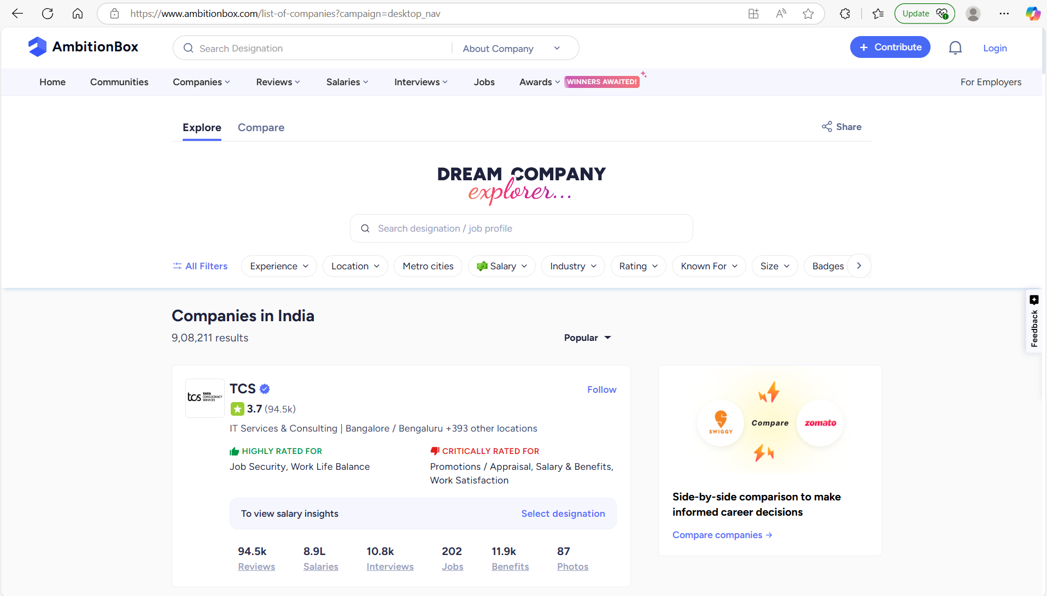
Data Collection
I collected data from the website called “AmbitionBox” from Companies section.

Slide 9
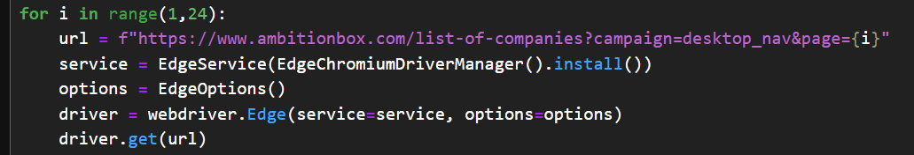
Data Collection Process
First I extracted every page link of AmbitionBox Companies using webdriver-manager of selenium and also with the help of Requests and BS4 python modules.
After getting URL of each page of companies request them and get the HTML content through Beautiful Soup and extract the targeted data from HTML content and append it to the every respective lists.
Again from each and every page go to the respective company page and extract the additional data and append it to the lists.
After extracting the data, created a DataFrame using list and saved the DataFrame to .csv file.

Slide 10
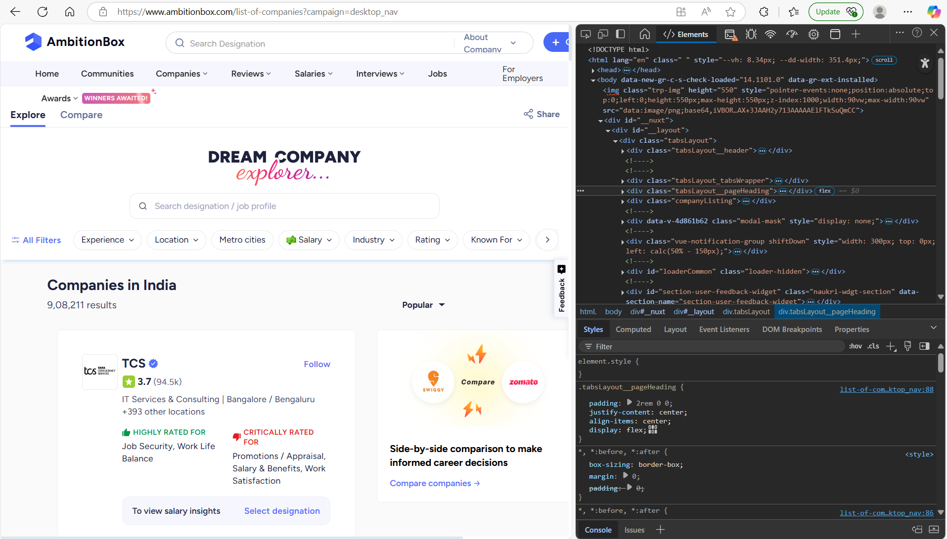
Website Overview

Slide 11
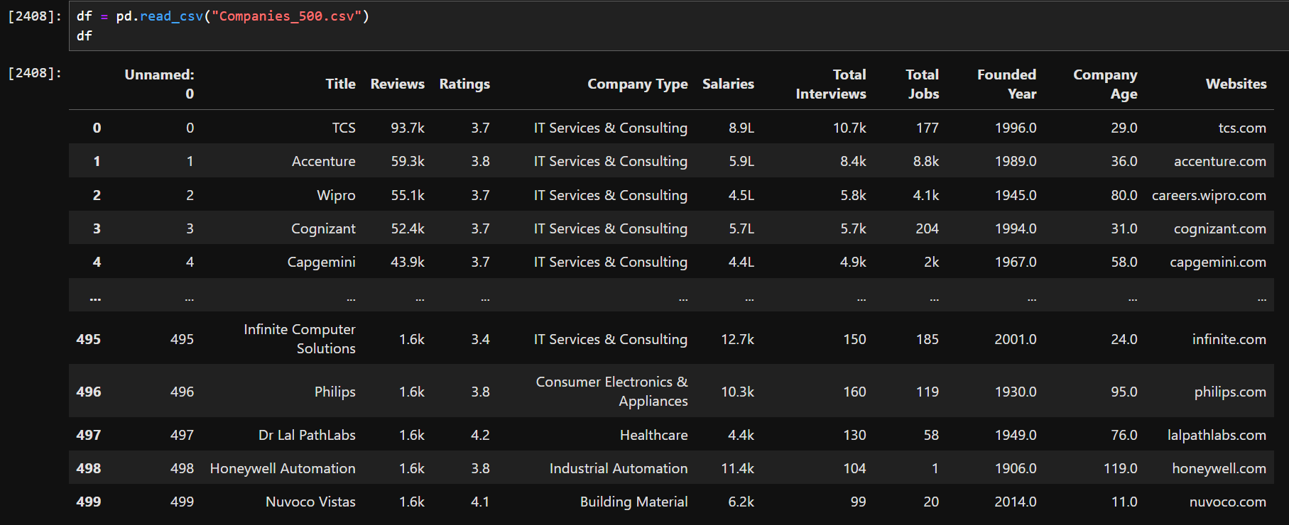
Raw Data Overview

Slide 12
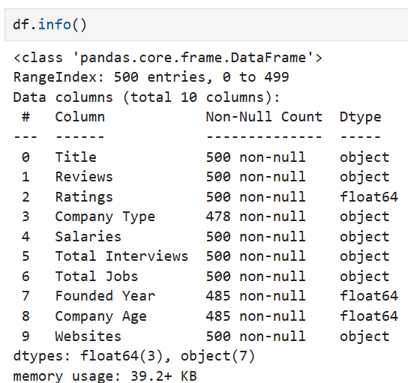
Features Extracted
Total Columns: 10
Title, Reviews, Ratings, Company Type, Salaries,
Total Interviews, Total Jobs, Founded Year, Company Age and Websites are the data we extracted from AmbitionBox.

Slide 13
Exploratory
Data
Analysis

Slide 14
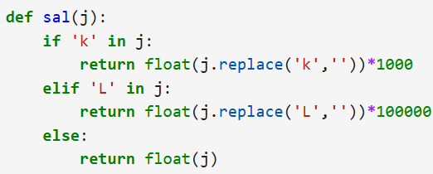
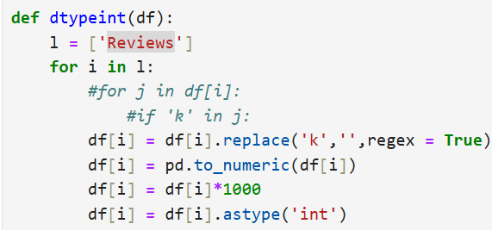
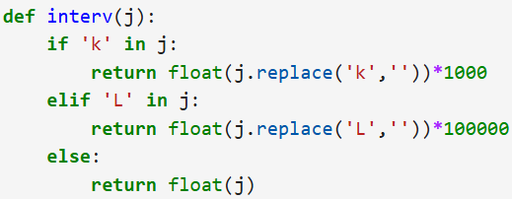
Data Cleaning
Replaced ‘--’ with ‘np.nan’ in ‘Total Jobs’ col.
Replaced ‘k’ with ‘’ and multiplied with 1000 &
Replaced ‘L’ with ‘’ and multiplied with 100000
for columns - Reviews, Total Jobs, Salaries, Total Interviews

Slide 15
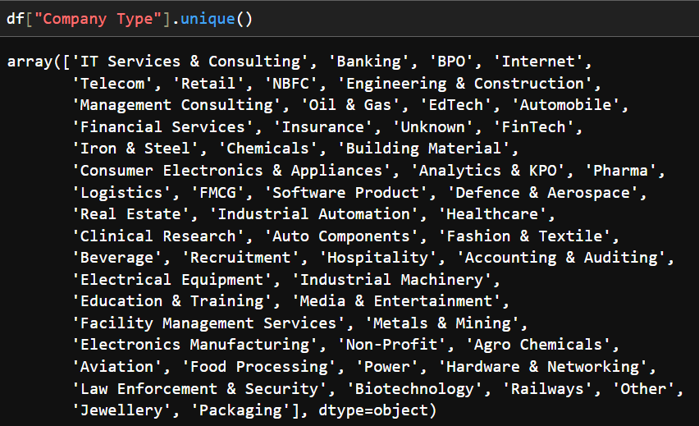
Data Cleaning - Extract col ‘Company Type’ unique values
Take look of ‘Company Type’ unique values.

Slide 16
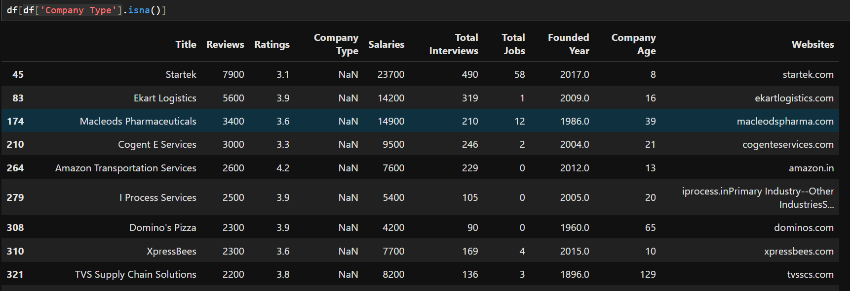
Data Cleaning - Checking Null values
Checking null values in ‘Company Type’ col.

Slide 17
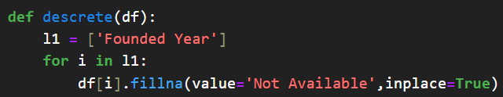
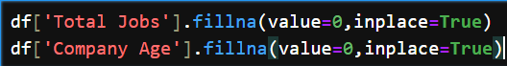
Data Cleaning - Filling Null Values
Filled Null values in ‘Founded Year’ col with ‘Not Available’.
Filled Null values in Total Jobs, Company Age col with 0.
Filled Null values in Company Type col with ‘Unknown’.

Slide 18
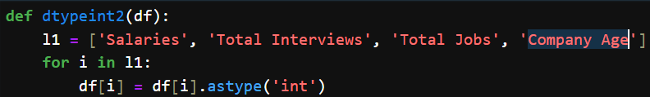
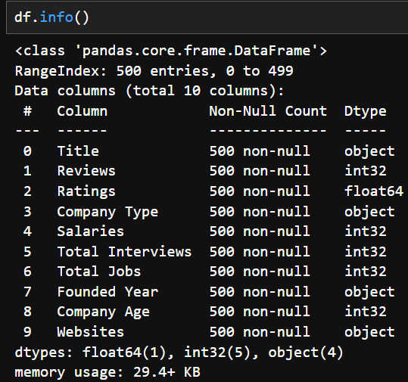
Data Cleaning - Type Conversion
Changed the datatype of the col’s- Salaries, Total Interviews, Total Jobs, Company Age.

Slide 19
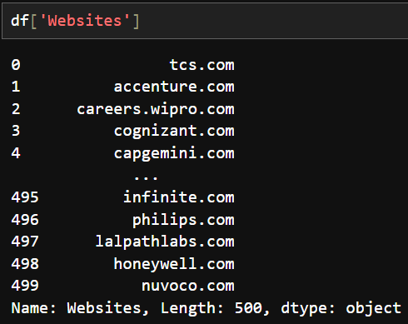
Data Cleaning - Regular expressions on Series col
There are a few rows containing paragraphs. I have used regular expressions on the 'Websites' column to extract the domain links of specific companies.

Slide 20
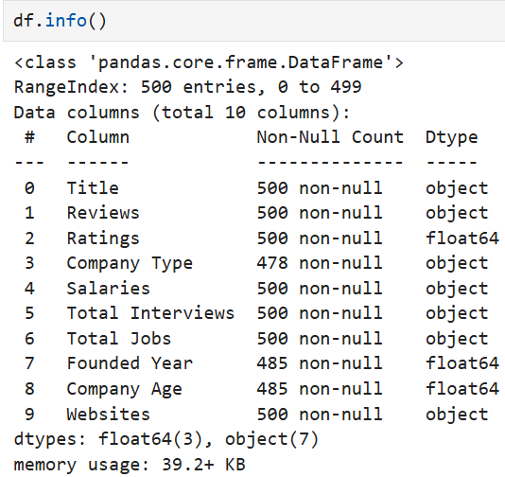
Data After Cleaning

Slide 21
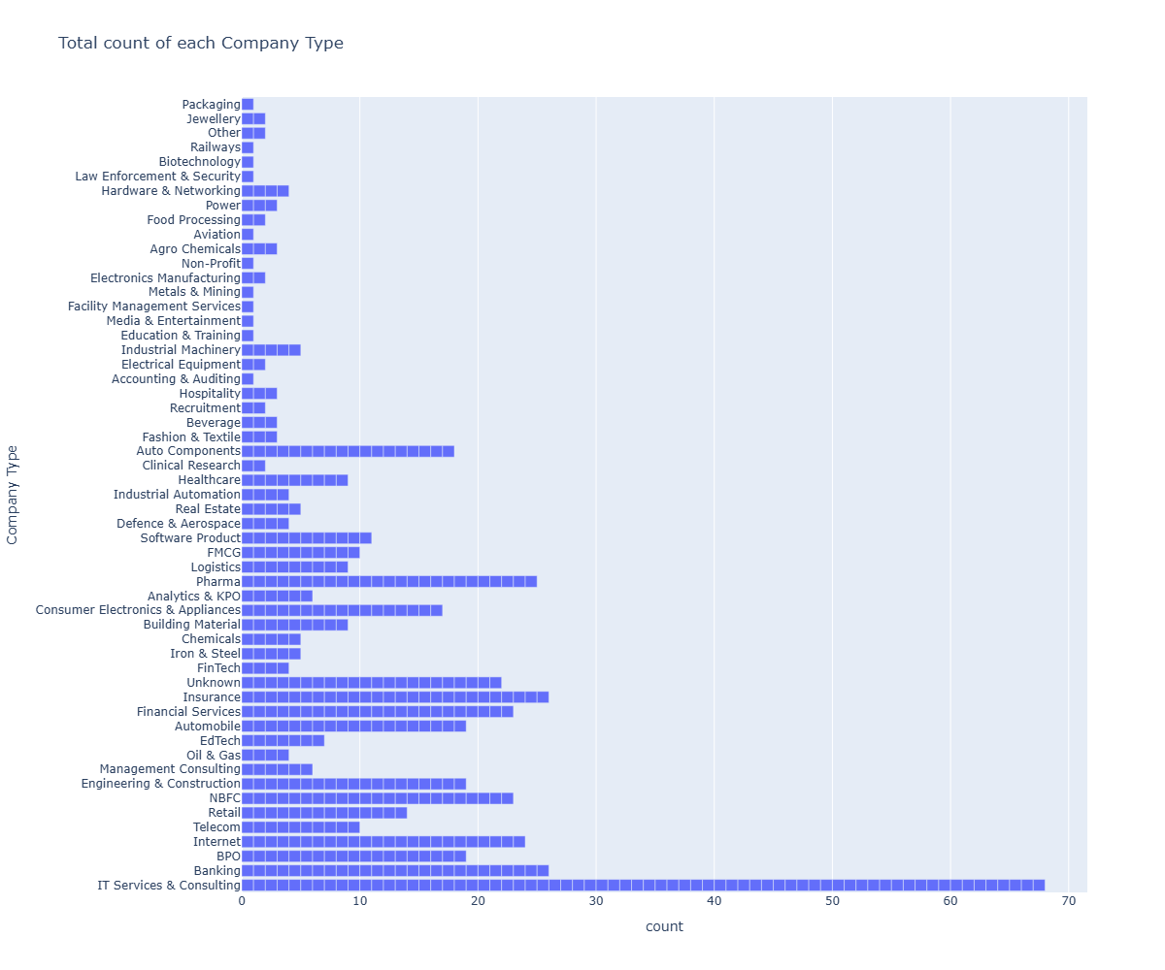
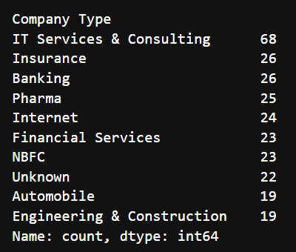
What are the Types of Companies?
There are total 55 types of companies.
The highest count of the type of company is “IT Services & Consulting”.
The top 10 types of companies are,

Slide 22
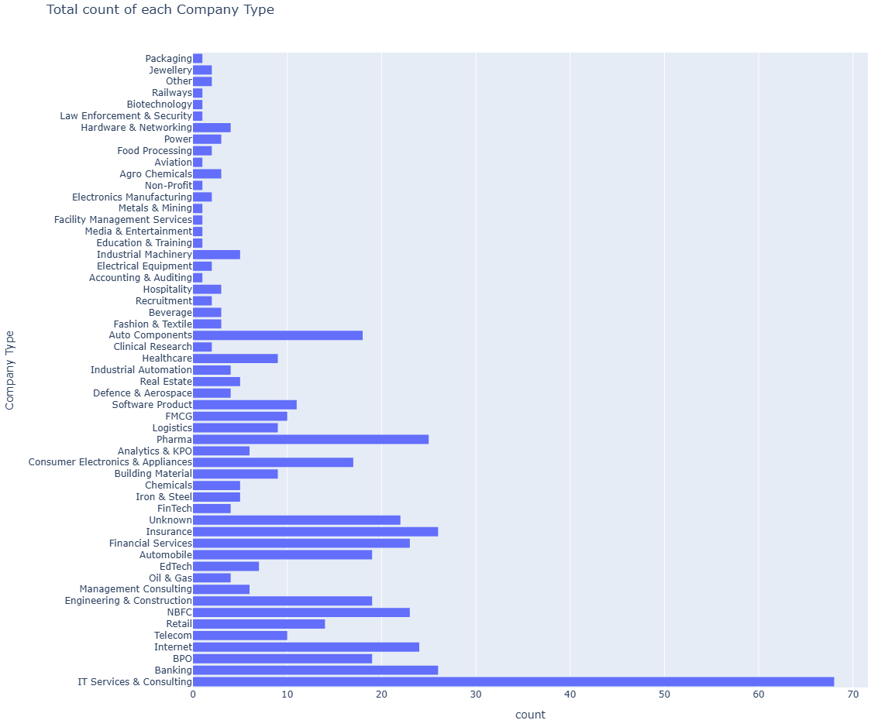
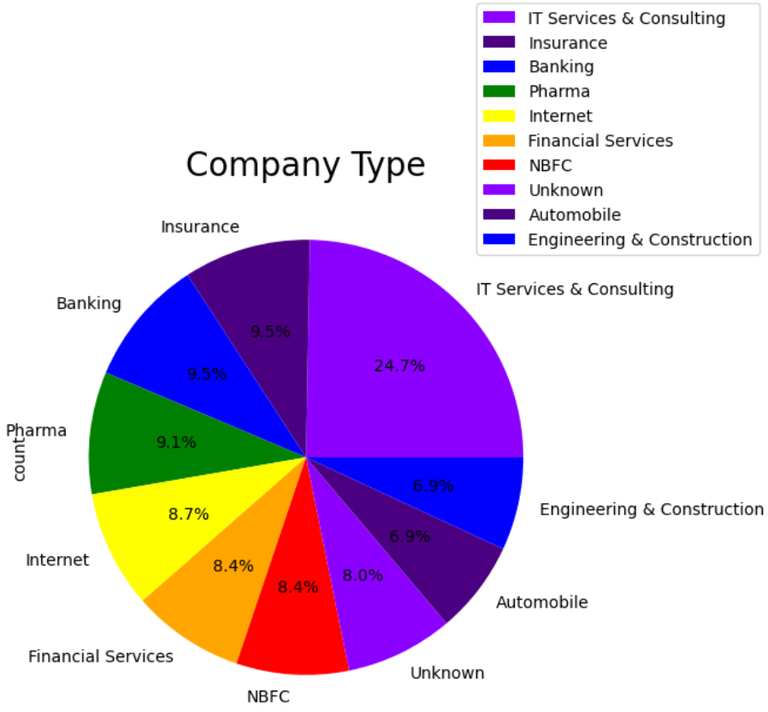
Types of Companies and their Distribution
‘IT Services & Consulting’ are more in our data.
Followed by ‘Banking’ and ‘Insurance’.

Slide 23
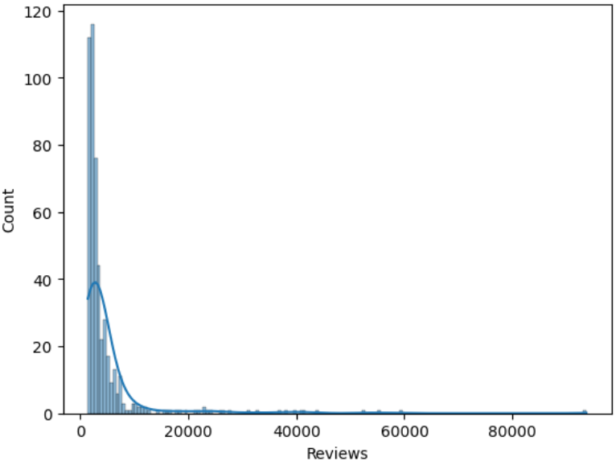
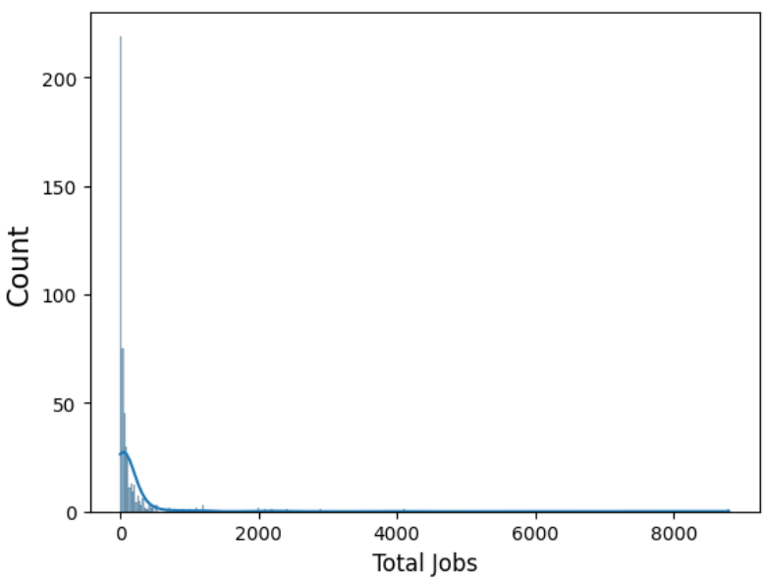
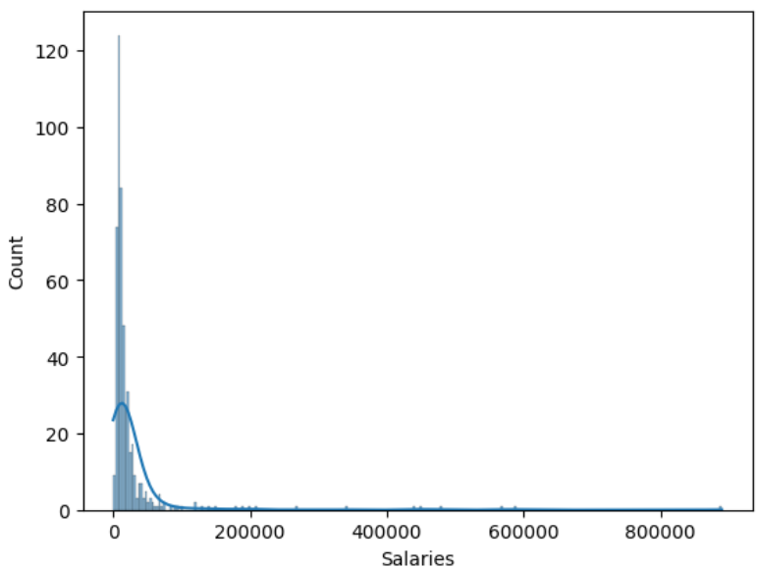
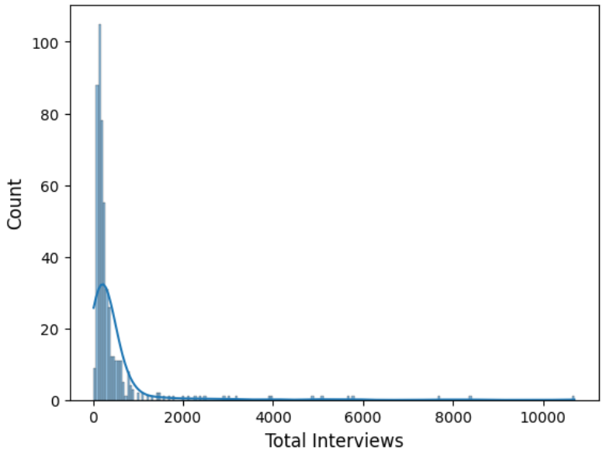
Distributions of each Numerical Columns
The distribution across the x-axis is very low for Reviews, Jobs, Salaries & Interviews.
Especially when it comes to the Jobs, Interviews & Salaries the distribution is very low across the x-axis.
The most of the data lies between,
-> 0 to 1000 for Jobs and Interviews
-> 0 to 10000 for Reviews & Salaries

Slide 24
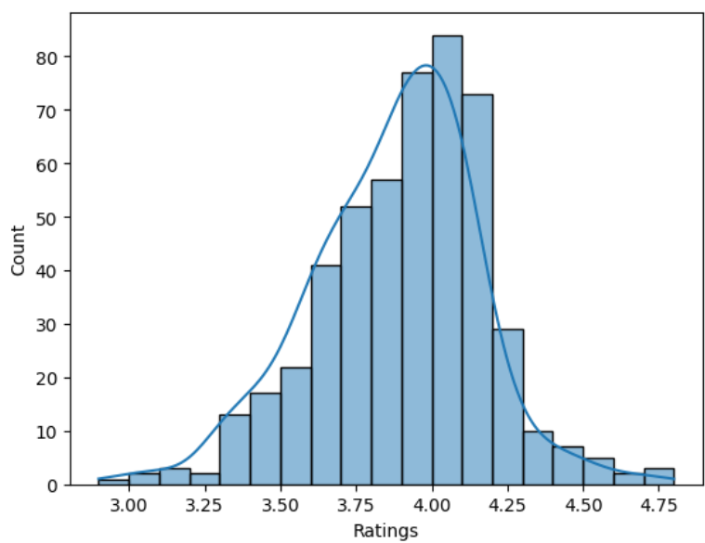
Distribution of Ratings
The histogram shows a bell-shaped curve, with most ratings clustering around 4.00.
In Ratings, most of the distribution happens around 3.75 to 4.25.
Most of the data lies between,
3.75 to 4.25.

Slide 25
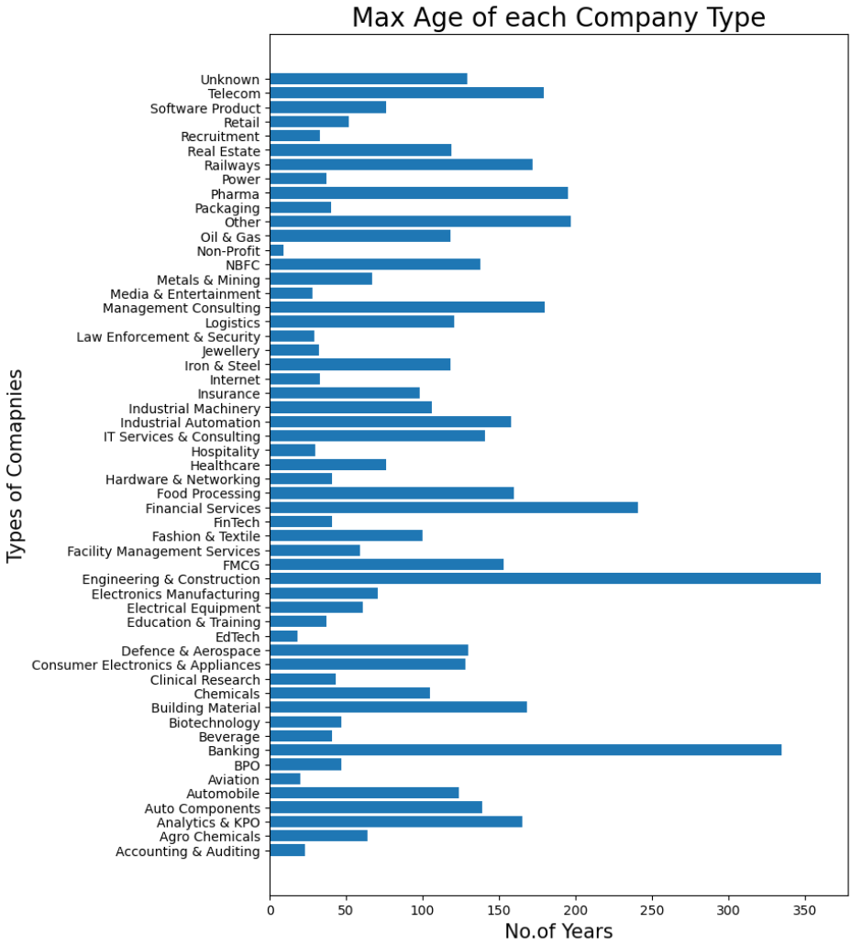
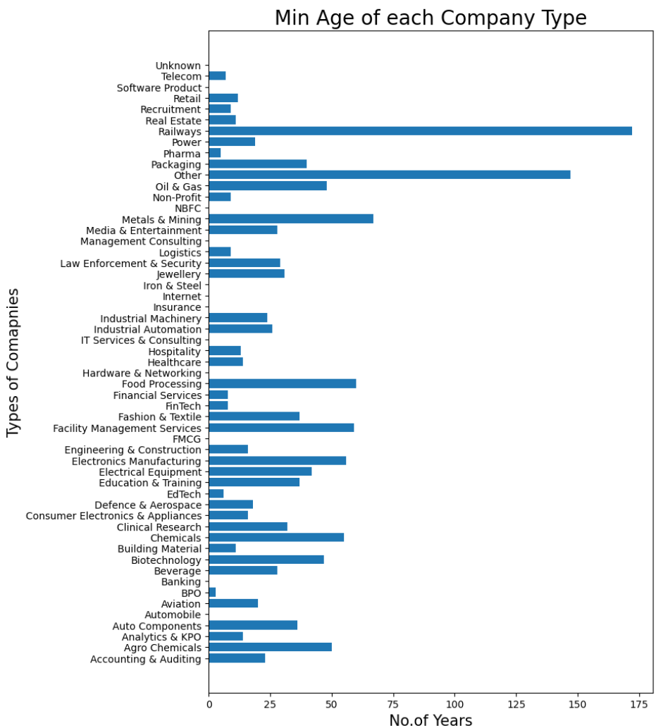
How Company Type described by its Age?
In these plots, ‘Engineering & Construction’ industry has the maximum age followed by ‘Banking’.
And ‘BPO’ has minimum age,
-> BPO - Business Process Outsourcing

Slide 26
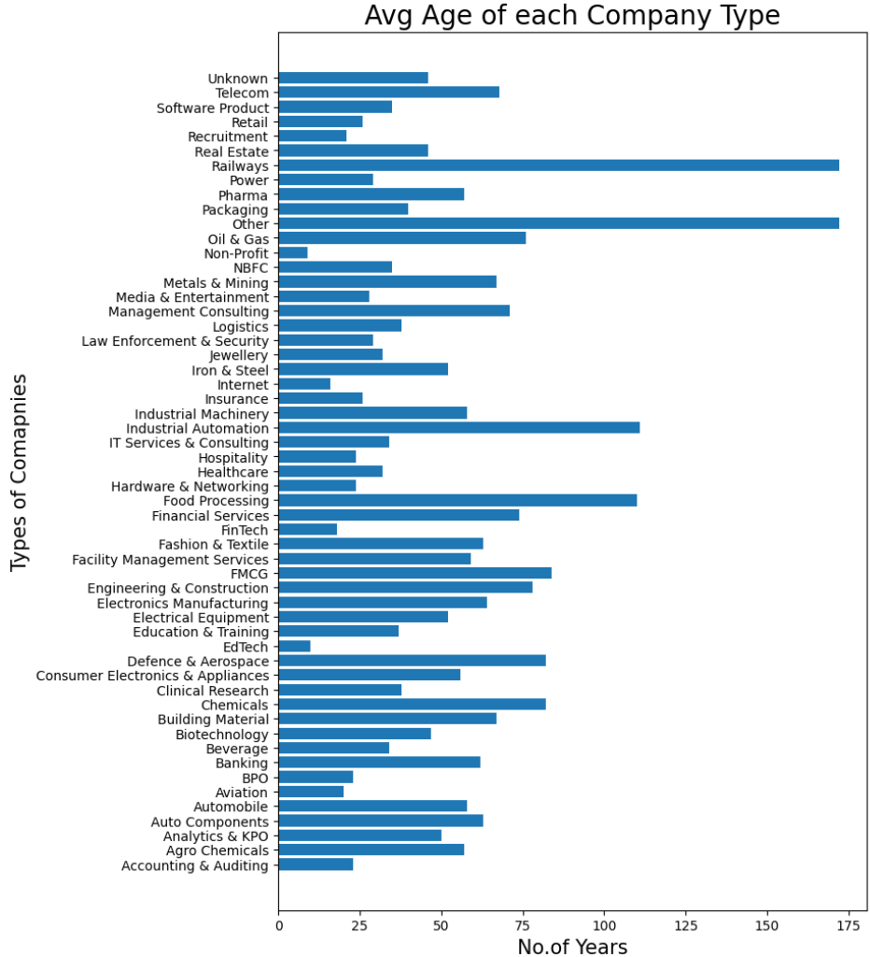
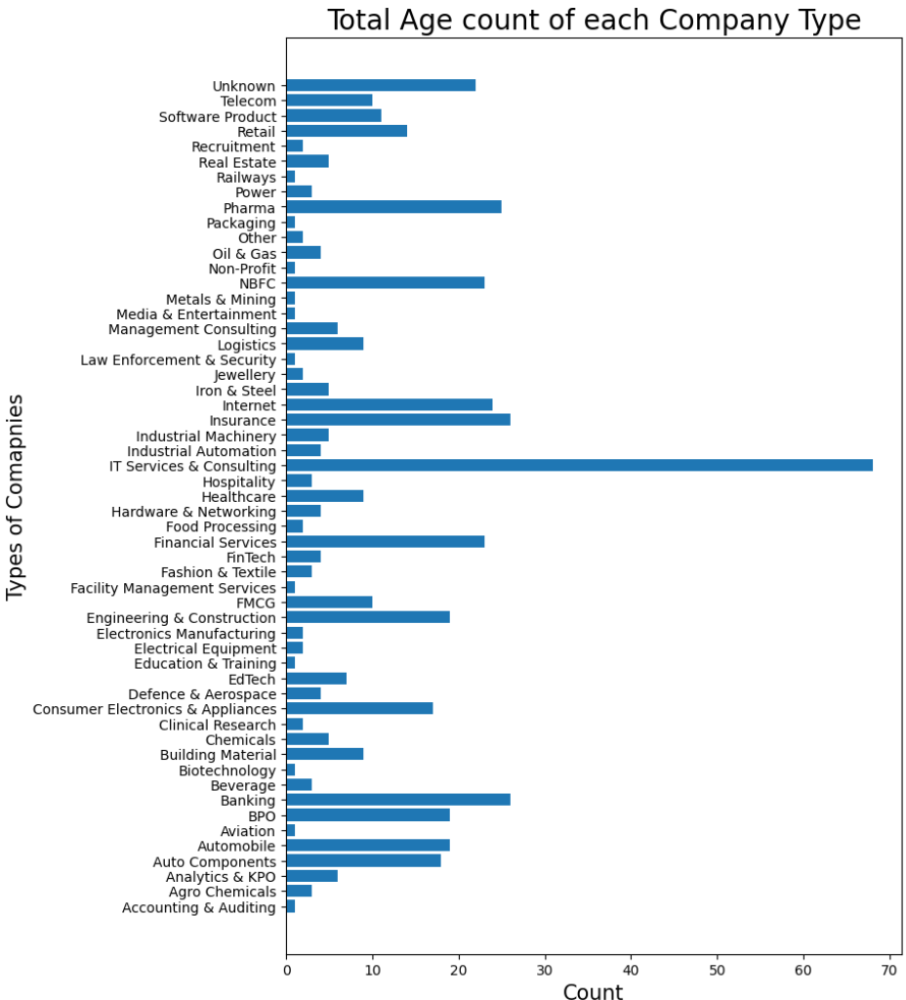
Average & Count of Age on each Company Type?
‘Railways’ has the highest Avg age followed by ‘others’.
‘IT Services & Consulting’ has the highest age count.
It shows that the ‘IT Services & Consulting’ industry is the primary industry among all the companies even though it has Minimum age.

Slide 27
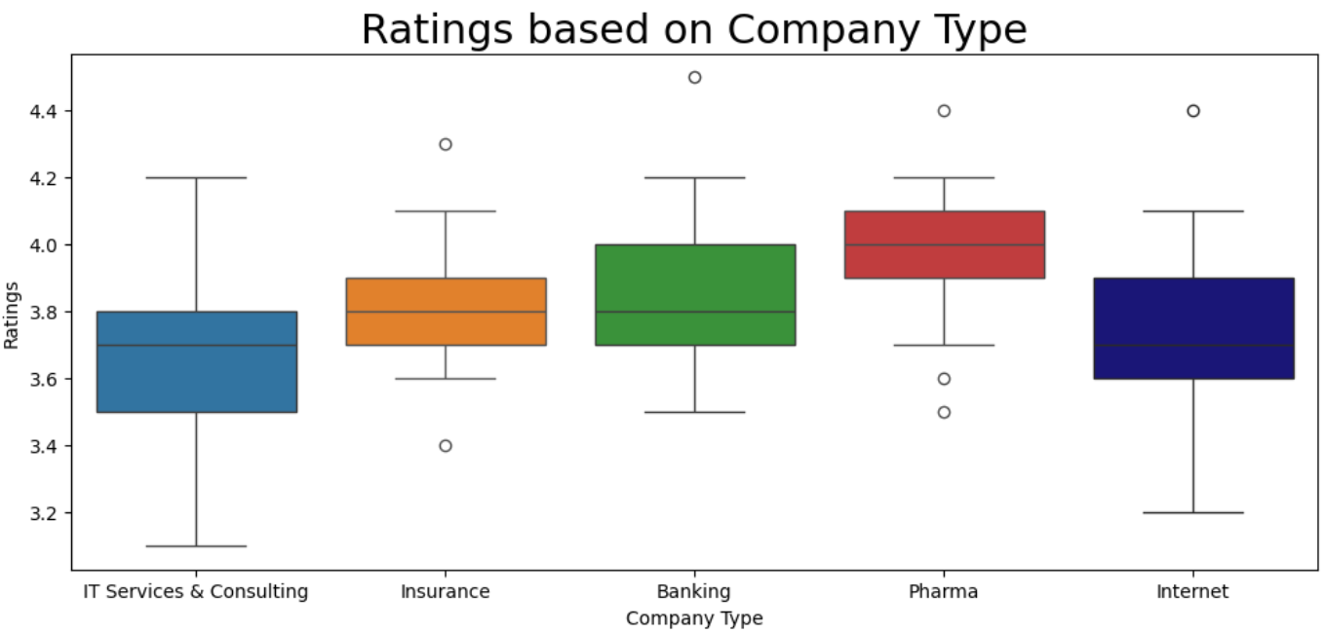
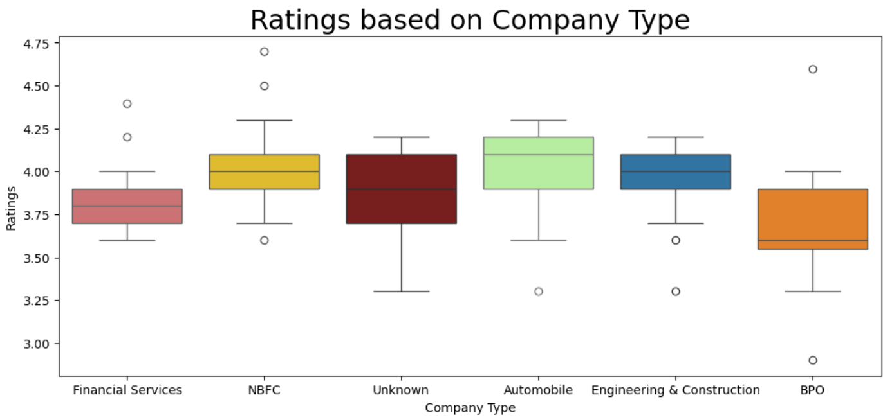
Ratings Based on Company Type
In ‘Internet’ industry the ratings are high compared to ‘IT Services & Consulting’ due to the users are high.
There are few Extreme low and high ratings for industries Banking, Pharma, Finance, NBFC and so on. This is due to users are more/less satisfied with the these Industries.
Most of the ratings around 3.5 to 4.2.
‘NBFC’, ‘Banking’, ‘Pharma’ & ‘Financial Services’ industries are highly satisfied by customers.
NBFC – Non-Banking Financial Company

Slide 28
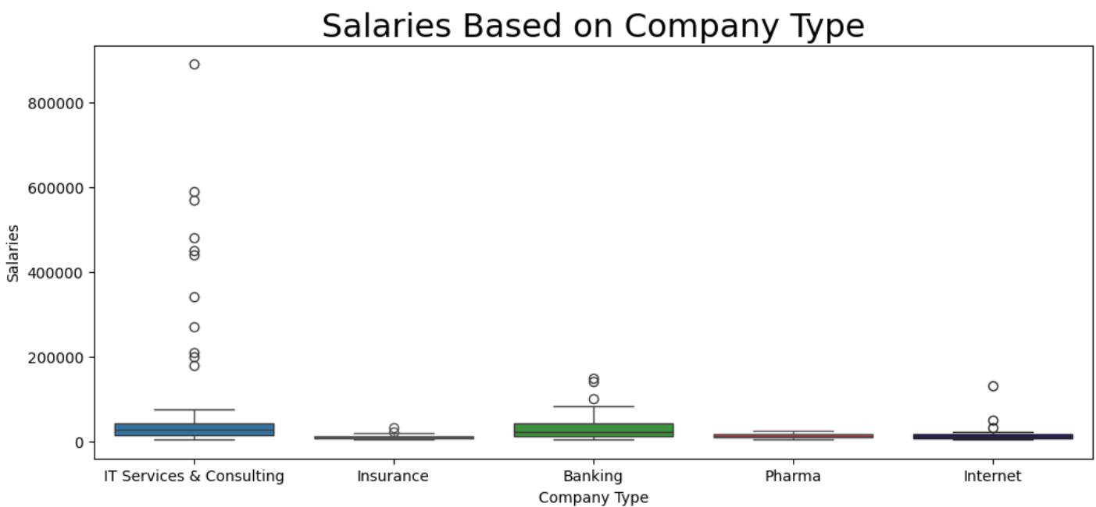
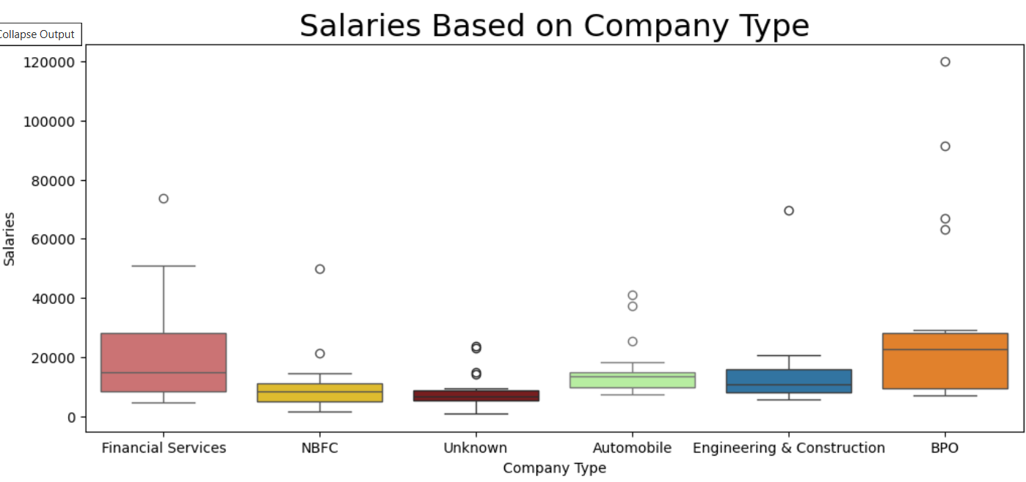
Salaries Based on Company Type
There are a few extremely high salaries in 'IT Services & Consulting.' These job positions are highly limited because they require highly skilled professionals.
In Insurance, Pharma, NBFC and Unknown industries offers very low salaries.
The highest salary is more than 8 lakhs which is offered by ‘IT Services & Consulting’.
And also most of the higher salaries are offered by ‘IT Services & Consulting’.

Slide 29
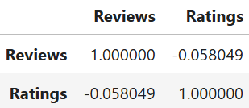
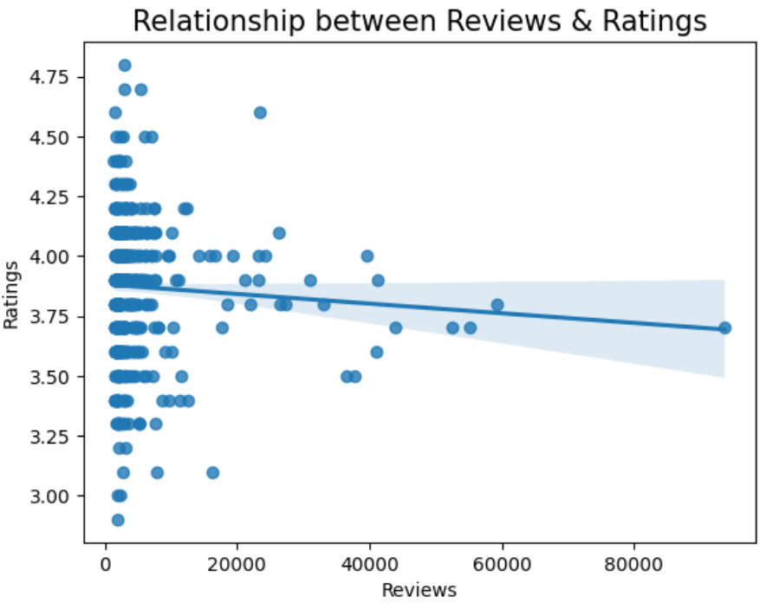
Relationship between Reviews & Ratings
As relationship between Reviews & Ratings is weak negative relationship.
Both are Independent in nature.
In this Regression plot the data is in non-linear way.
The shaded region around the trend line represents a confidence interval, confirming the general pattern that ratings decrease as review counts rise.

Slide 30
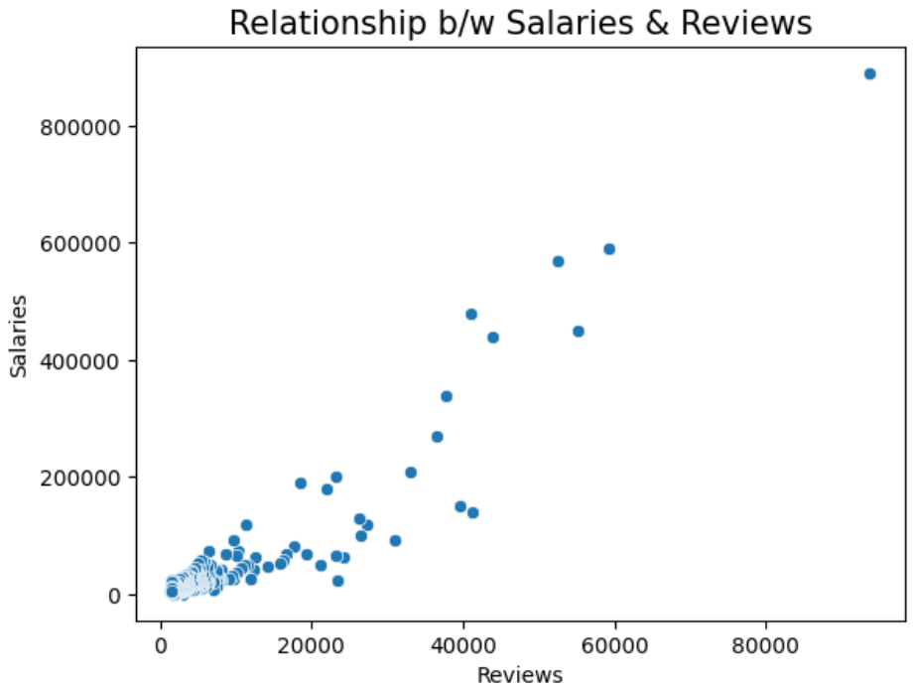
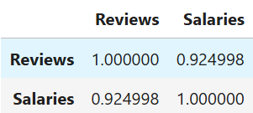
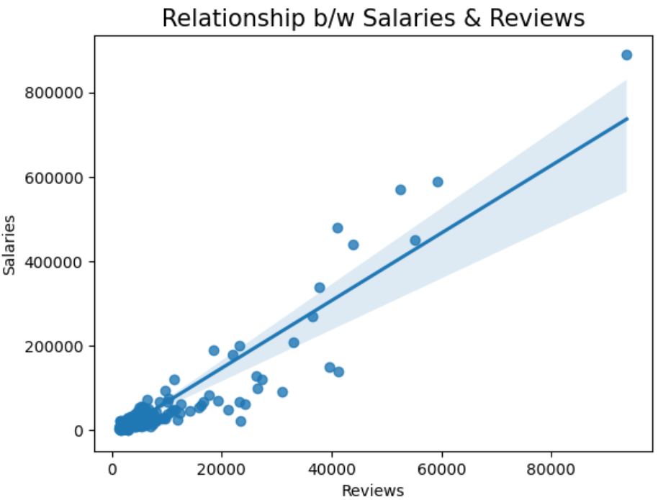
Relationship between Reviews & Salaries
The relationship between Salaries & Reviews is Strongly Positive.
As if the Reviews are increasing the Salaries also increasing.
As you observe the data is in a linear shape. From the regression plot we can say that the data is in linear way.
Both Reviews and Salaries are dependent on each other.

Slide 31
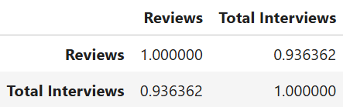
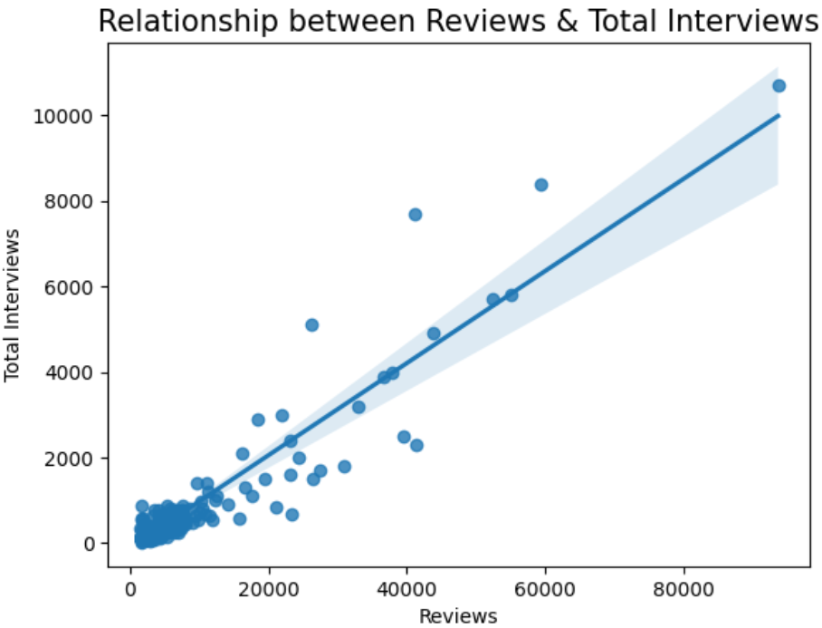
Relationship between Reviews & Interviews
The relationship between Reviews & Interviews is Strongly Positive.
As if the Reviews are increasing the Interviews also increasing.
As you observe the data is in a linear shape. From the regression plot we can say that the data is in perfectly linear way.
Both Reviews and Interviews are dependent on each other.

Slide 32
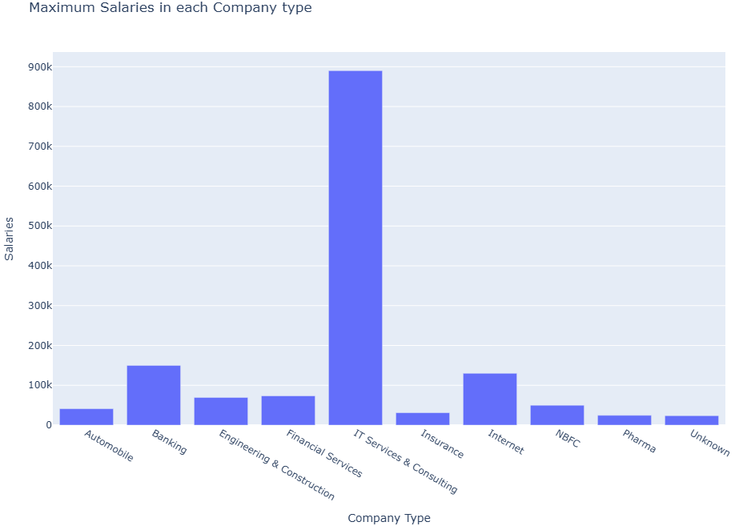
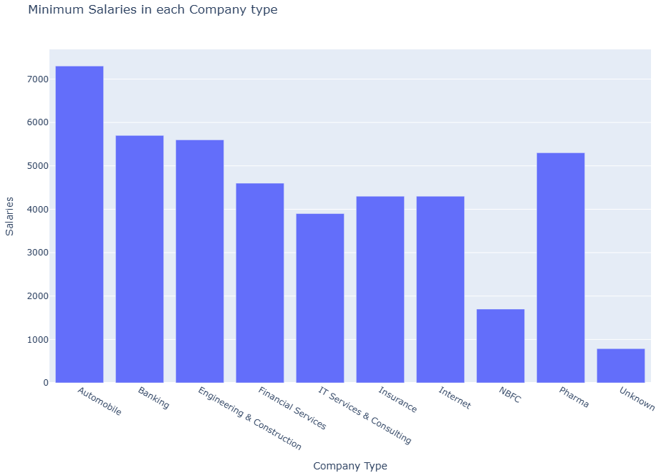
How the Industries are affected by Salaries?
The Highest salary is providing by ‘IT Services & Consulting’ industries which is greater than 800k .
The Lowest salary is providing by an ‘Unknown’ industries which is less than 1000.
Most of the prominent industries salaries are ranged between 1000 to 900k.
Within this range, a skilled employee in the 'IT Services & Consulting' industry is offered a salary between 100K and 900K.

Slide 33
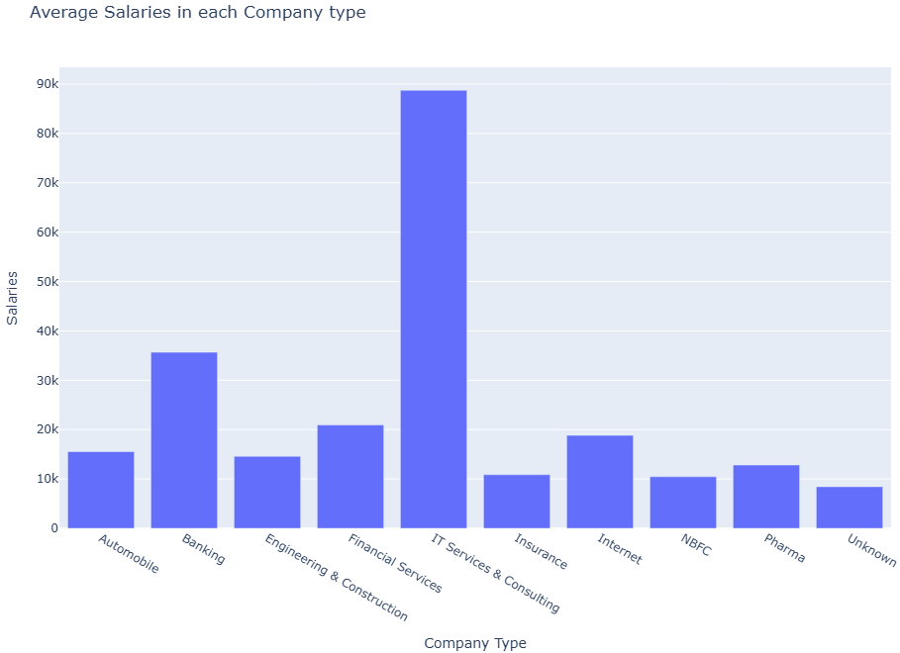
Average Salary offered by each industry
The ‘IT Services & Consulting’ industry offers an average salary around 80k to 90k.
An Average minimum salary is offered by an ‘NBFC’ and ‘Unknown’ industries which is less than 10k.
Banking Follows with Competitive Salaries (~40K).
The demand for ‘IT Services & Consulting’ is high compared to other Industries.

Slide 34
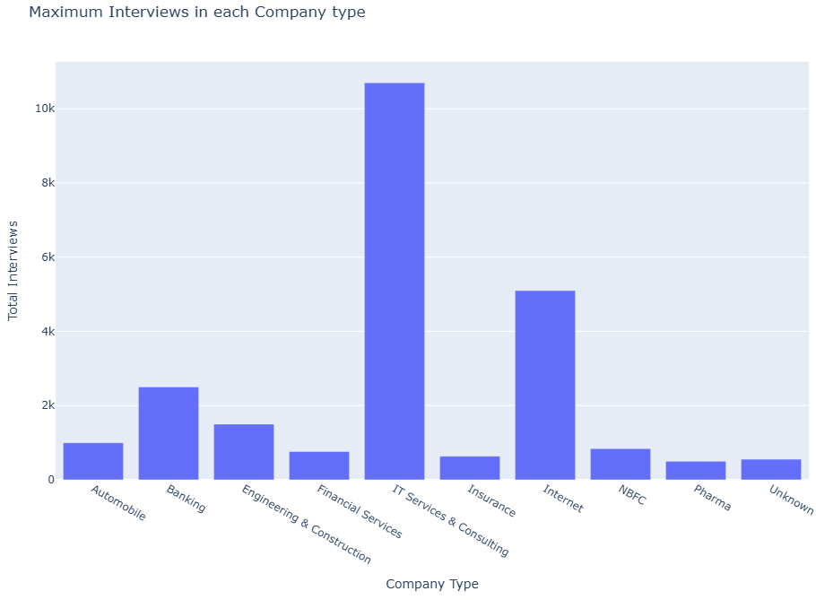
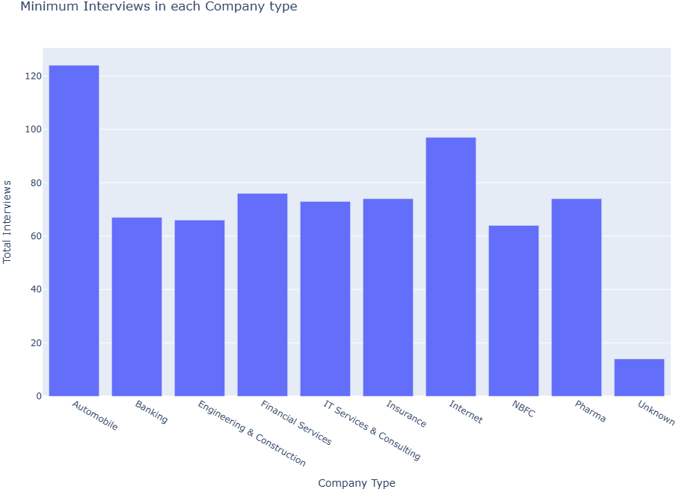
Min & Max Interviews conducted by each Industry
The maximum number of interviews are conducted by the 'IT Services & Consulting' industry, exceeding 10K.
The least number of interviews are conducted by 'unknown' industries, totaling fewer than 20.
The highest number of interviews are conducted by the 'IT Services & Consulting' industry, as it is one of the fastest-growing large industries in the world.

Slide 35
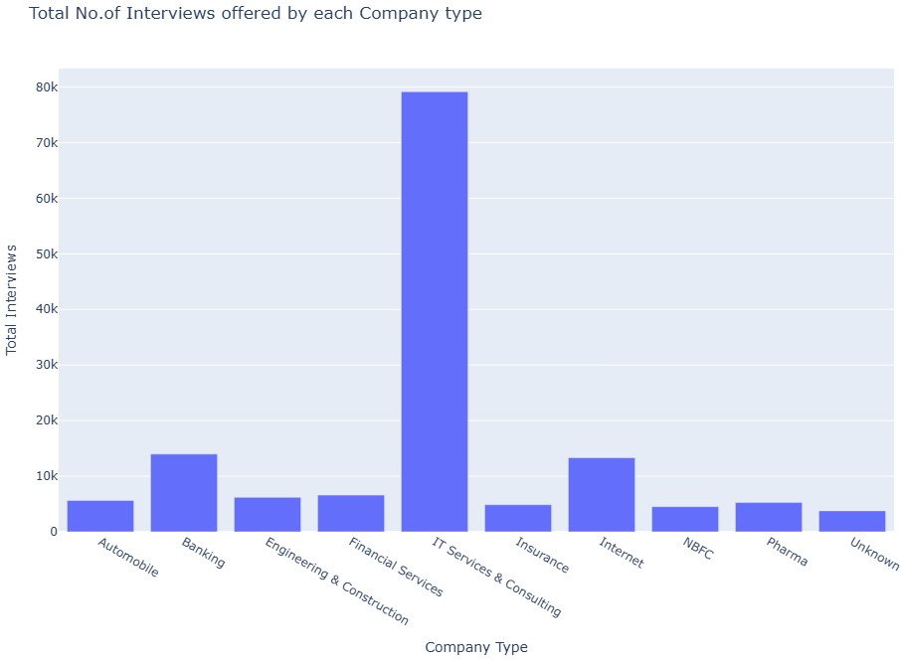
Total Number of Interviews conducted by each Industry
The most no.of Interviews are conducted by ‘IT Services & Consulting’ industry which is more than 70k.
The least no.of Interviews are conducted by an ‘Unknown’ industry which is less than 5k.
Other than ‘Unknown’ industry the least no.of Interviews are conducted by ‘NBFC’, which is less than 10k.
NBFC - Non Banking Financial Company.

Slide 36
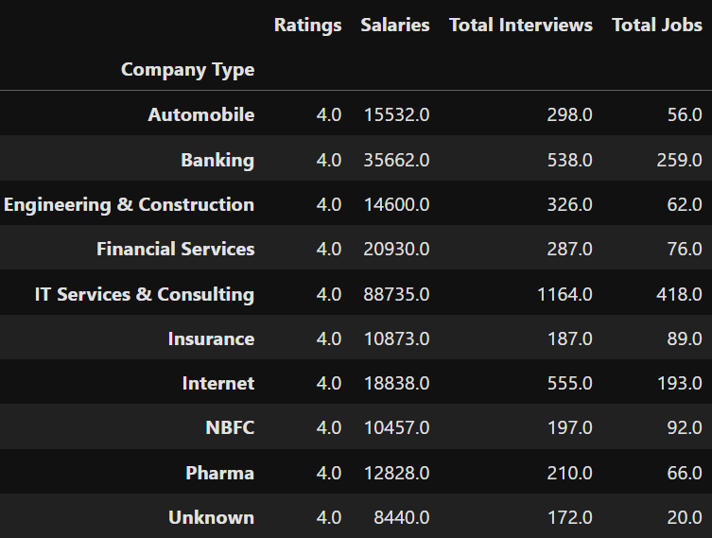
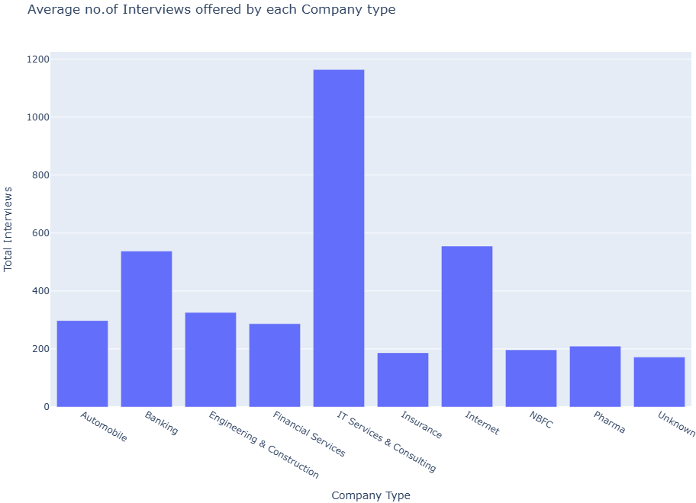
Average no.of Interviews conducted by each Industry
The ‘IT Services & Consulting’ industry conducts an average no.of Interviews around 1000 to 1200.
The average minimum number of interviews conducted by the 'Insurance' and 'Unknown' industries which is less than 200.
There are more no.of openings in ‘IT Services & Consulting’ industry.

Slide 37
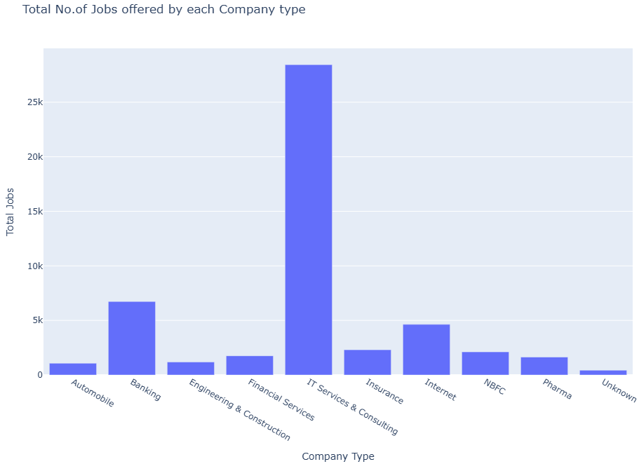
Total Number of Jobs offered by each Industry
The most no.of jobs are offered by ‘IT Services & Consulting’ industry which is more than 25k.
The least no.of jobs are offered by an ‘Unknown’ industry which is less than 5k.
Other than ‘Unknown’ industry the least no.of jobs are offered by ‘Automobile’ industry, which is less than 5k.

Slide 38
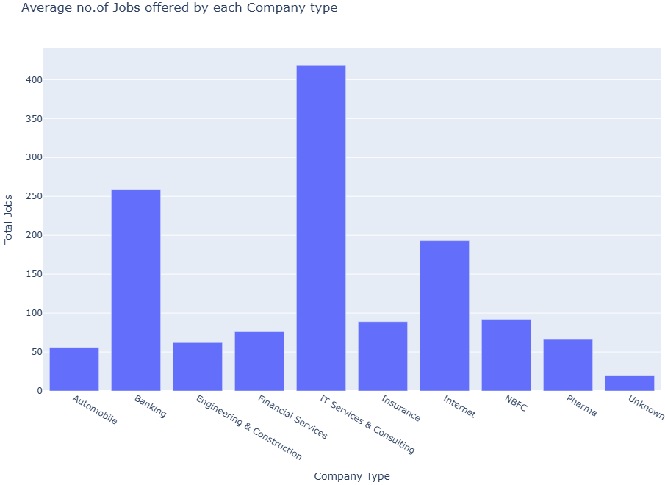
Average no.of Jobs offered by each Industry
The ‘IT Services & Consulting’ industry offers an average no.of jobs which is more than 400.
The ‘Automobile’ and ‘Unknown’ industries offers the least average no.of jobs which is less than 100.
There are more no.of job openings in ‘IT Services & Consulting’ industry.

Slide 39



Did High Reviews of Companies give High Salaries?
The relationship between both Reviews and Salaries is strongly positive in nature.
As the Reviews are increasing the Salaries are also increasing. Both are dependent on each other.
The Correlation between Reviews and Salaries is 0.96.

Slide 40


Did High Ratings of Companies give High Salaries?
The relationship between both Ratings and Salaries is weak negative in nature.
Both the Ratings and Salaries are Independent.
The Correlation between Ratings and Salaries is -0.3.

Slide 41


Salaries vs Jobs based on each Company Type

Slide 42

Interviews vs Jobs based on each Company Type

Slide 43

Visualizing Correlations: Pairplot Across Company Metrics

Slide 44


Company Data Correlations: A Heatmap Perspective

Slide 45
General Insights: On Heatmap Perspective
Companies conducting more interviews and offering higher salaries appear to be actively growing and more visible in terms of employee engagement.
The weak relationship between ratings and salaries suggests that workplace culture, benefits, and job roles might play a bigger role in employee satisfaction.
Company Age does not strongly impact salaries or hiring trends, which means newer and older firms operate on different business models with varied compensation strategies.

Slide 46
Overall Insights of the project
IT Services & Consulting leads with the highest salaries, while NBFC & Banking sectors offer structured but lower pay scales.
High ratings do not necessarily correlate with high salaries, suggesting compensation isn’t the sole factor driving employee satisfaction.
IT & Banking sectors are aggressive recruiters, posting the most jobs and conducting the highest number of interviews.
Pharma & Insurance follow selective hiring models, resulting in fewer interviews per hire.
NBFC leads in job postings, indicating expansion-driven recruitment strategies in financial services.
Companies with higher employee reviews tend to offer better salaries, meaning that well-paying firms generate more employee feedback.
Total interviews positively correlate with salary, reinforcing the idea that high-paying firms have competitive hiring cycles.

Slide 47
Final Conclusion on Types of Companies
My EDA on AmbitionBox Top 500 Companies has revealed key insights into salaries, hiring trends, employee engagement, and industry variations:
IT Services & Consulting offers the highest salaries, while NBFC & Banking maintain structured but lower pay scales.
High ratings don’t guarantee high salaries—NBFC firms score well despite moderate pay.
Aggressive hiring is seen in IT & Banking, while Pharma & Insurance follow selective recruitment models.
Companies with high interview counts tend to pay better salaries, reinforcing competitive hiring patterns.
Key Takeaway: Salary alone doesn’t define employee satisfaction—industry stability, hiring trends, and engagement levels matter.

Slide 48
Any
Questions?

Slide 49

THANK YOU!

